Slide 1
Today’s Agenda
Discussion of Dataset
Problem Statement
Overview of Classification Techniques
EDA & Correlation Heatmap
Detailed Classification Analysis
Conclusions

Slide 2
Introduction
Football being a very popular and one of the high profile game is known to produce a high revenue. Billions of dollars are invested into this sport
FIFA has generated a whopping $7.5 billion in 2022 till date
With so much at stake there is always a major factor with correct investments on players
With the help of FIFA data set of all payers from 2015 till 2022 we will be providing solutions to determine a player’s wage
Helping with problems such as huge losses to clubs, wrong investments in players, economical use of transfer windows

Slide 3
Motivation
Player and club rankings can be easily determined from past and current performances
Many criticisms occurred in the last few years due to some tremendous salaries given to the football players
Lack of concrete model to determine correct salaries for players
Major economical support to clubs and players

Slide 4
Data Set
Referring FIFA data set of all players from 2015 to 2022
Dataset consists of all attributes of a player including player_attributes, work_rate, potential, wage_eur etc
Historical comparison between players
This helps in determining at which point the budget does not allow to buy significantly better players for the 11-men lineup

Slide 5
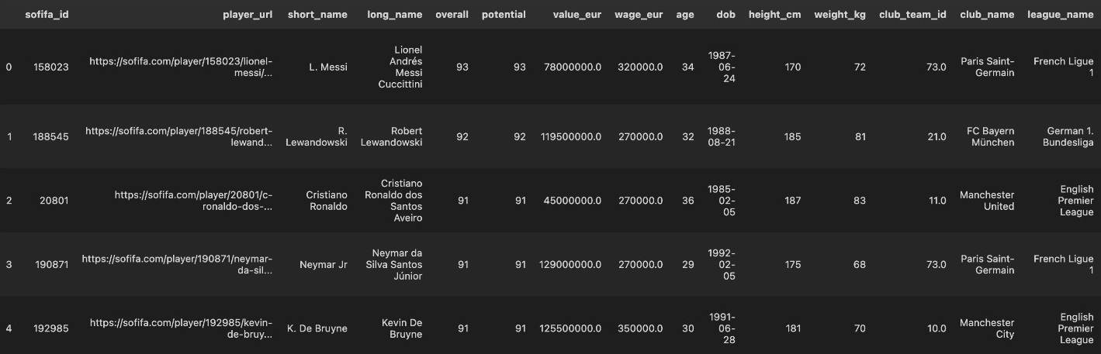
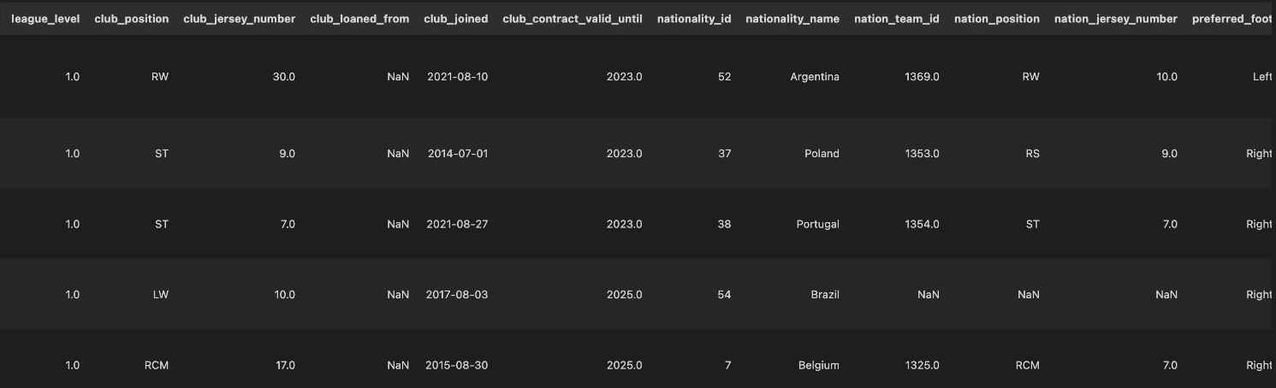
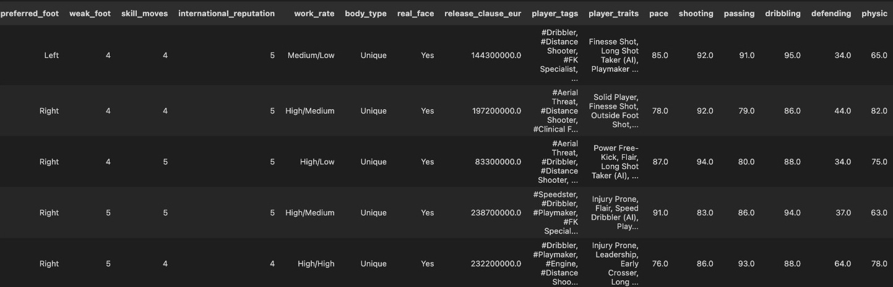
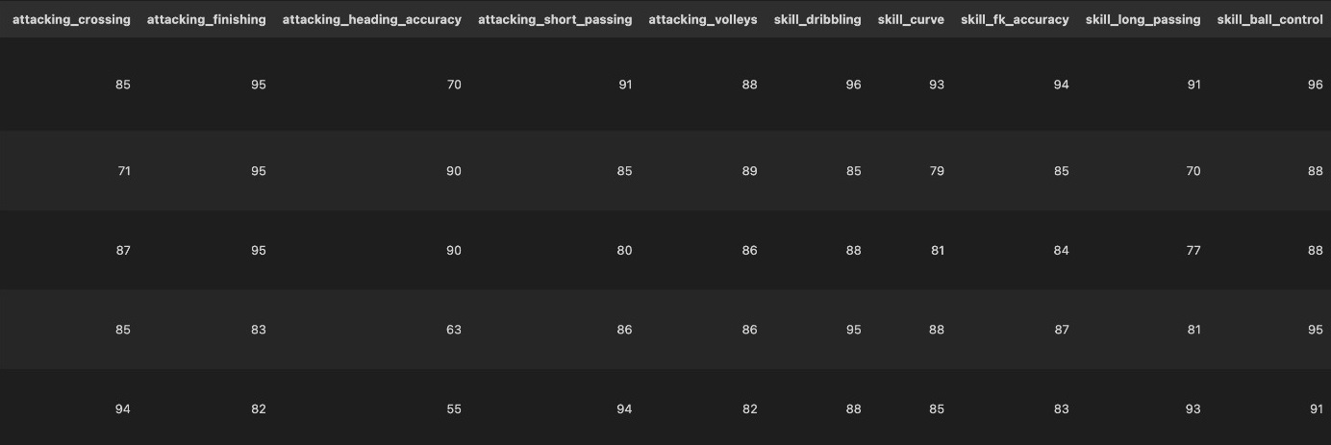
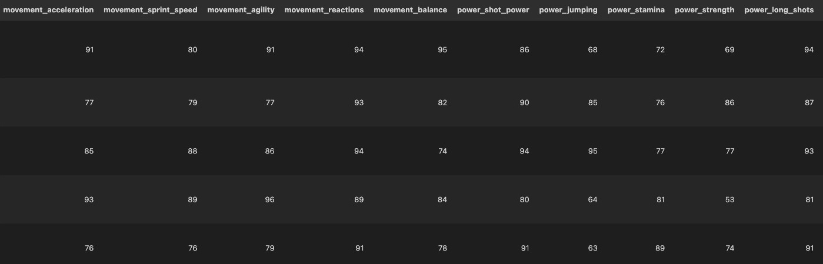
Columns

Slide 6
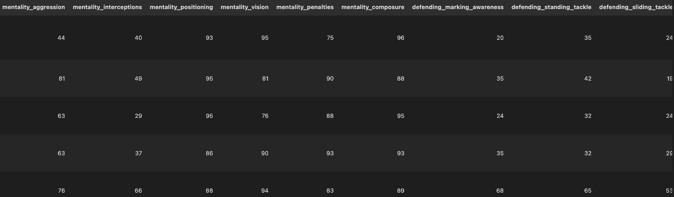
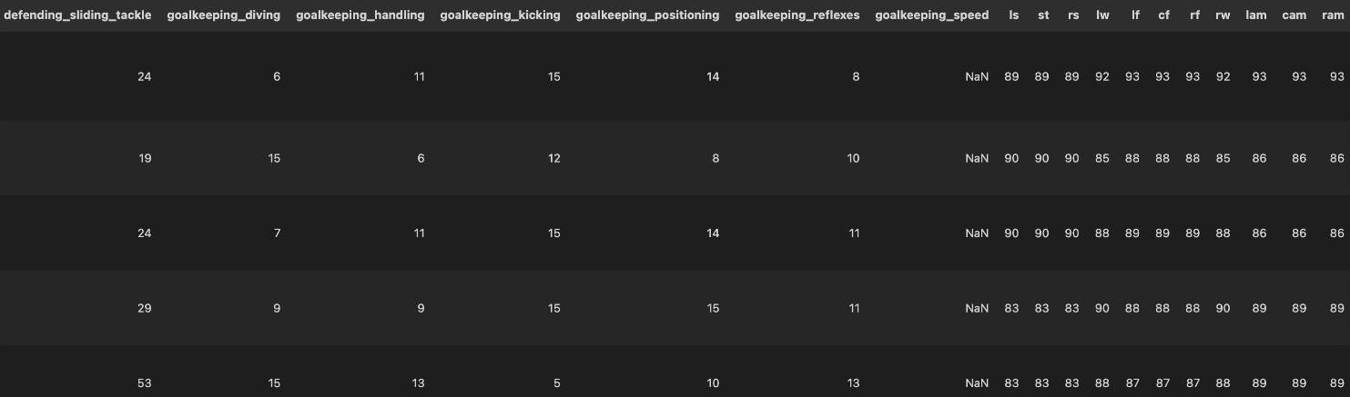
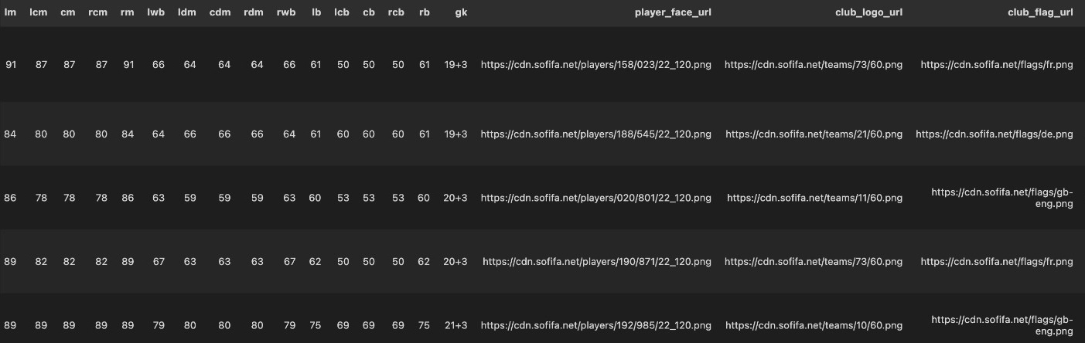
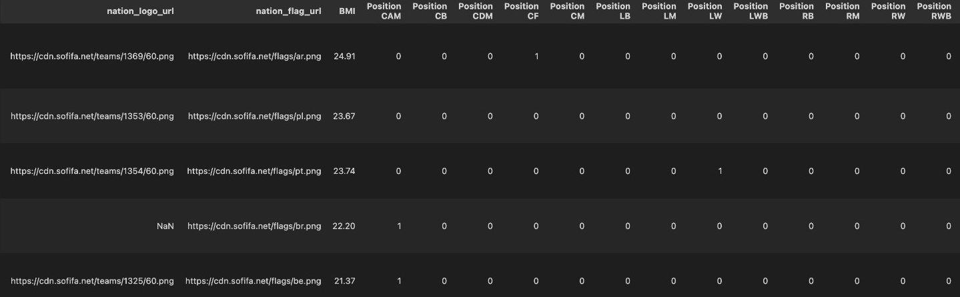
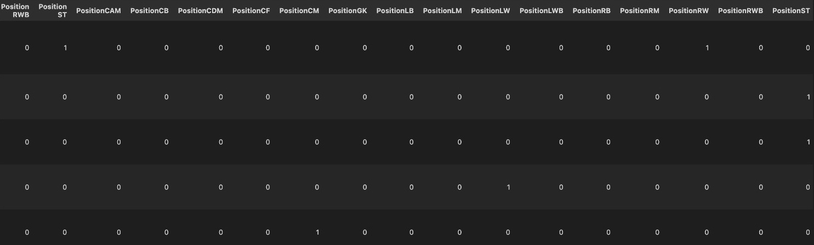
Columns

Slide 7
Types of Column
Objects:
url - player_url,club_flag_ur,nation_logo_url,nation_flag_url,player_face_url,club_logo_url
name - short_name, long_name,club_name, league_name,nationality_name
time - dob,club_joined
player positions -club_position,nation_position,
Other Attributes -preferred_foot, work_rate, body_type, real_face, player_tags, player_traits,club_loaned_from
Integer:
General - sofifa_id, overall, potential, age, height_cm, weight_kg, nationality_id
Attributes - weak_foot, skill_moves, international_reputation, attacking_crossing, attacking_finishing, attacking_heading_accuracy, attacking_short_passing, attacking_volleys, skill_dribbling, skill_curve, skill_fk_accuracy, skill_long_passing, skill_ball_control, movement_acceleration, movement_sprint_speed, movement_agility, movement_reactions, movement_balance, power_shot_power, power_jumping, power_stamina, power_strength, power_long_shots, mentality_aggression, mentality_interceptions, mentality_positioning, mentality_vision, mentality_penalties, mentality_composure, defending_marking_awareness, defending_standing_tackle, defending_sliding_tackle, goalkeeping_diving, goalkeeping_handling, goalkeeping_kicking, goalkeeping_positioning, goalkeeping_reflexes, Wage_Increase
Positions - ls,st,rs,lw,if,cf,rw,lam,cam,ram,lm,lcm,cm,rcm,rm,ldm,cdm,rdm,lwb,rwb,lb,lcb,cb,rcb,rb

Slide 8
New Columns
'value_eur', 'wage_eur', 'age', 'club_team_id', 'nationality_id', 'release_clause_eur', 'attacking_crossing', 'skill_long_passing', 'movement_balance', 'power_shot_power', 'power_jumping', 'defending_sliding_tackle', 'mid', 'bck', ‘fwd’
Total of 15 columns are used at the end

Slide 9
Importance of Wages
Wages are mainly affected by the income of the clubs but also the position on the pitch, the image a player brings, his age, and the grade he receives (which includes goals, assists etc)
Our analysis shows that the income generated by the leagues and their derivative businesses was a strong determinant of wages given to their players

Slide 10
Feature Selection
linear classification model with L1 regularisation is used for feature selection
All the features with weights assigned as 0 by the model is dropped
L1 regularisation is majorly used for feature selection
L1 regularisation uses the absolute weights in the objective function to penalise the model
This way while training, useless features weights are pushed to 0

Slide 11
Feature Engineering
For the purpose of our classification task we need to build a new column
We have a continuous column wages_eur for each years dataset
A new column named Wage_Increase is added indicating whether there is increase, decrease or same wage
This is achieved by:-
Identifying a common set of players in both datasets (21 and 22)
Comparing the wages of the common set of players
Adding a new target variable Wage_Increase into the 21 dataset which indicates whether the corresponding values in the 22 dataset are higher, lower or stay the same.

Slide 12
Data Cleaning
All columns that were URL website links were removed
All Columns that had null values with counts more than 9000 null values were removed
Player position scores were changed from object type to integer
76+2 -> 76
All the other columns of object type were removed
long_name, player_positions, dob, club_name, league_name, club_position, club_joined, nationality_name, preferred_foot, work_rate, body_type, real_face, player_traits
All rows with null/nan values were amputated with the mean value of that column

Slide 13
Exploratory Data Analysis

Slide 14
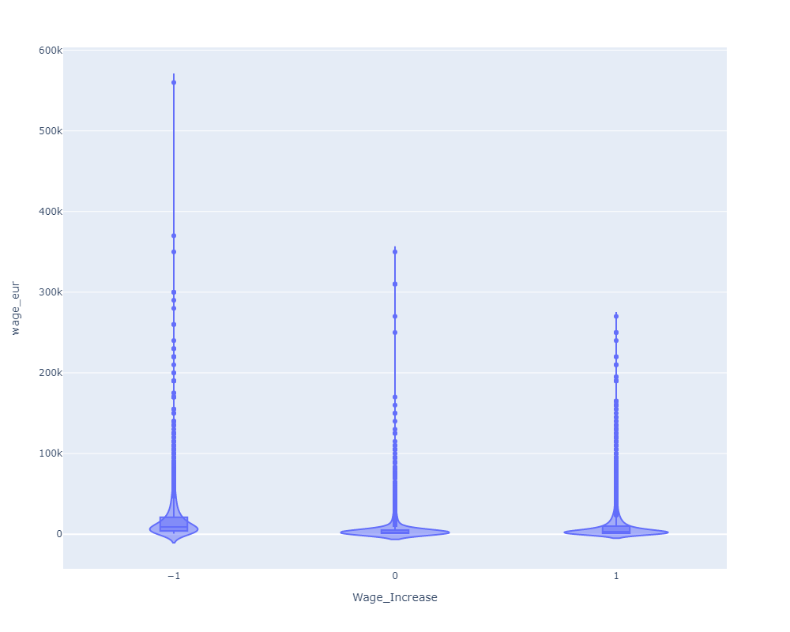
Notes:
wage doesnt only increase but can decrease also

Slide 15
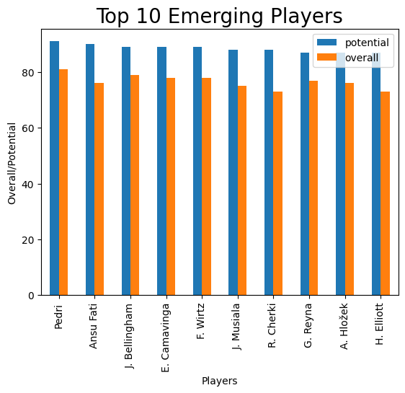
Notes:
wage doesnt only increase but can decrease also

Slide 16
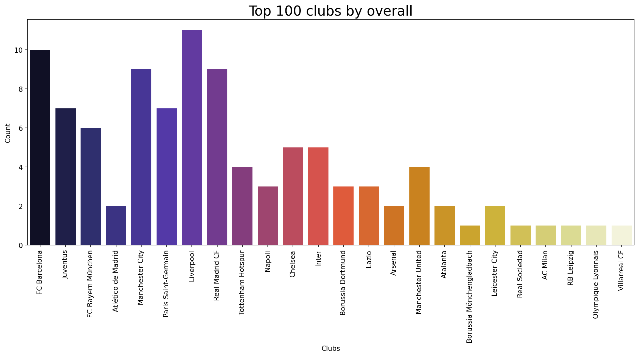
Notes:
wage doesnt only increase but can decrease also

Slide 17
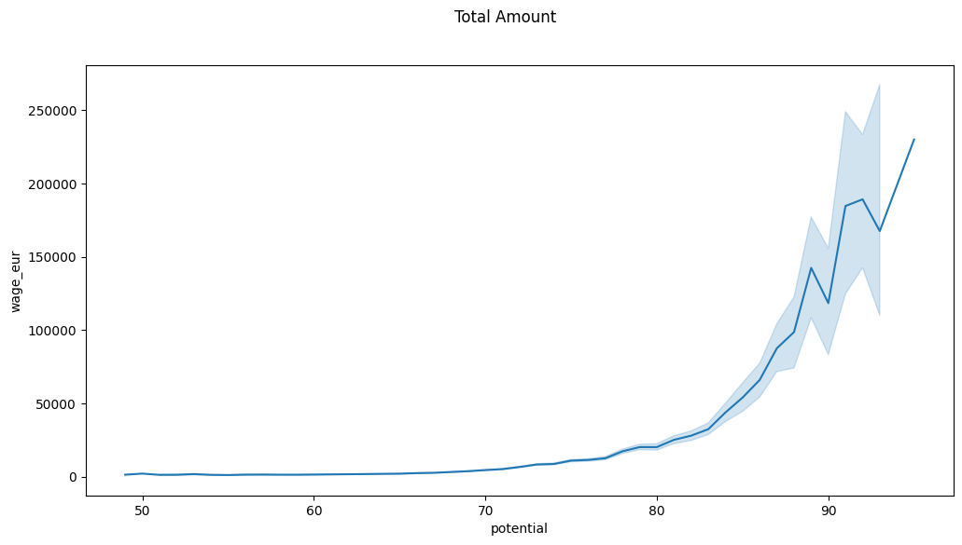
Notes:
wage doesnt only increase but can decrease also

Slide 18
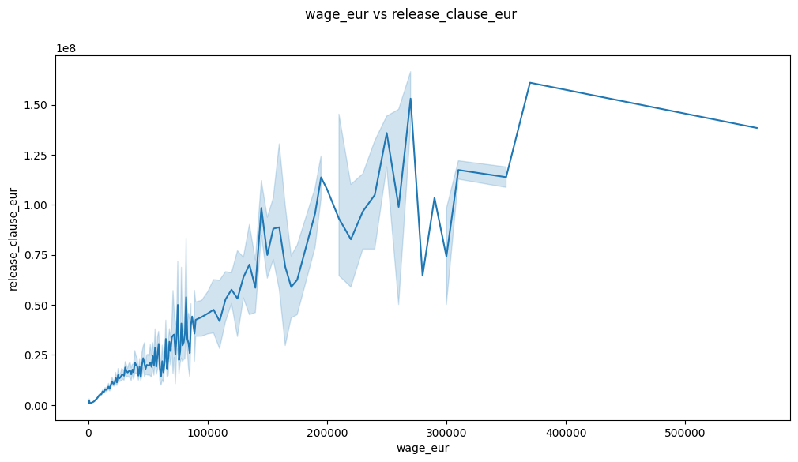
Notes:
wage doesnt only increase but can decrease also

Slide 19
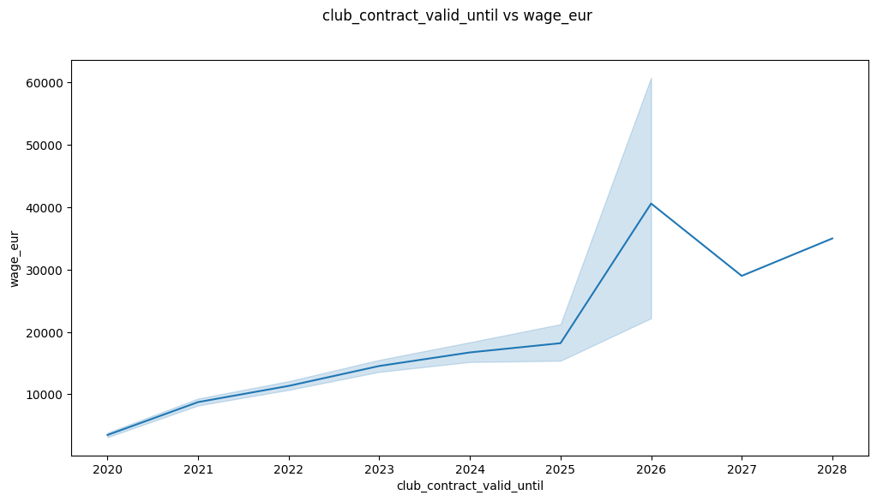
Notes:
wage doesnt only increase but can decrease also

Slide 20
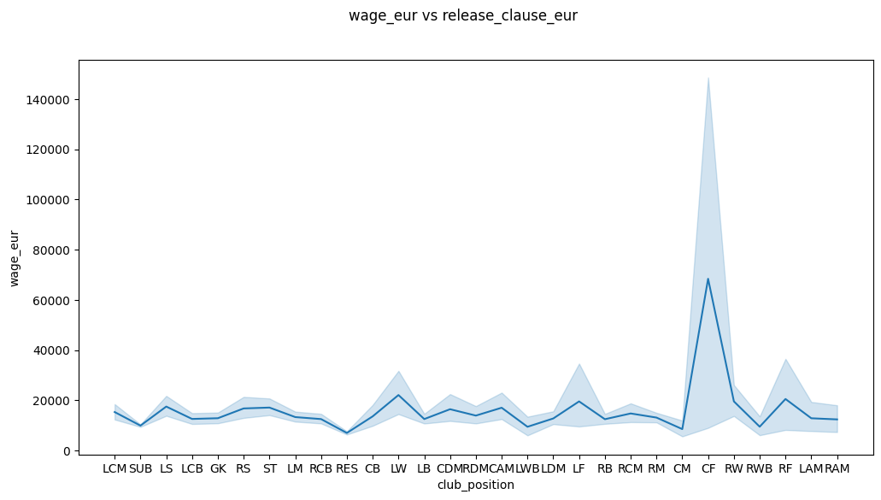
Notes:
wage doesnt only increase but can decrease also

Slide 21
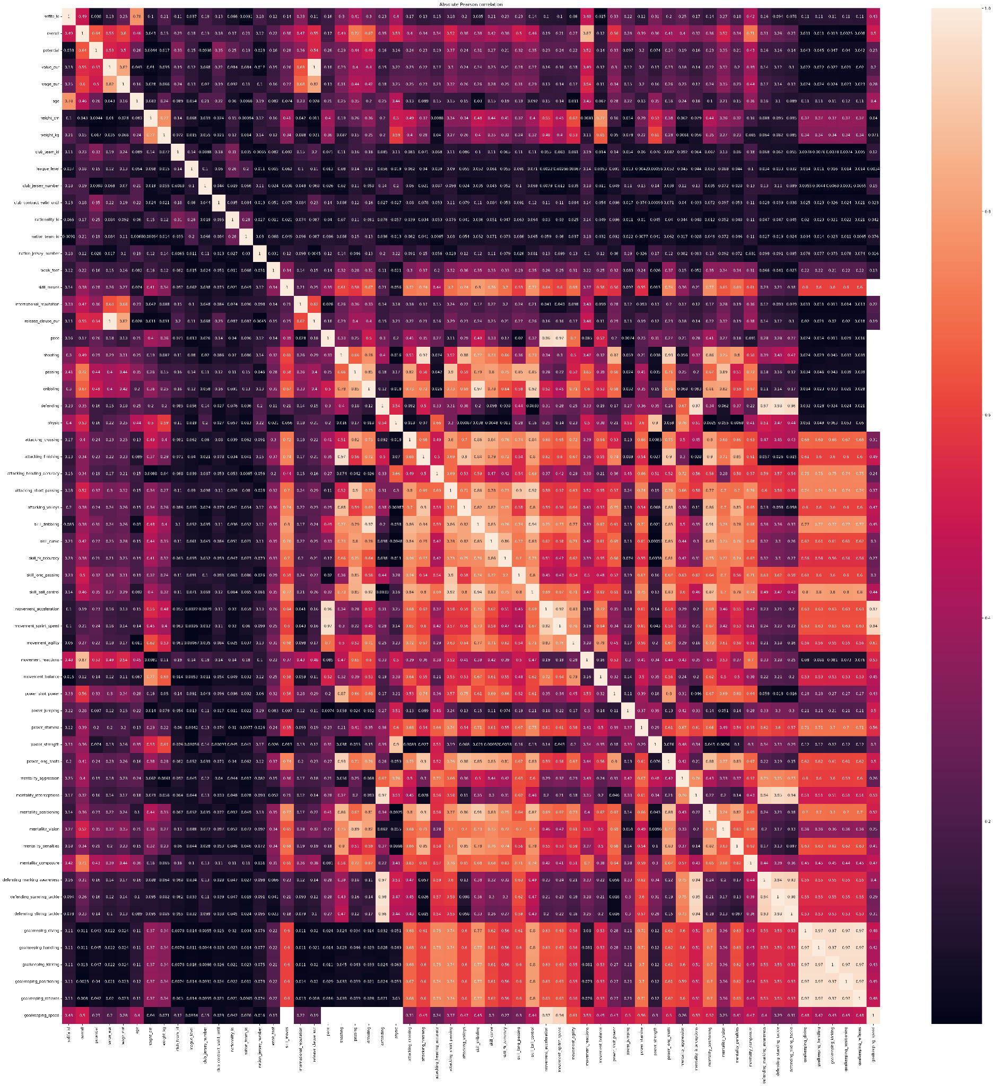
Notes:
as we see that the alot of features arent correlated hence the need of data cleaning and maybe some feature engineering

Slide 22
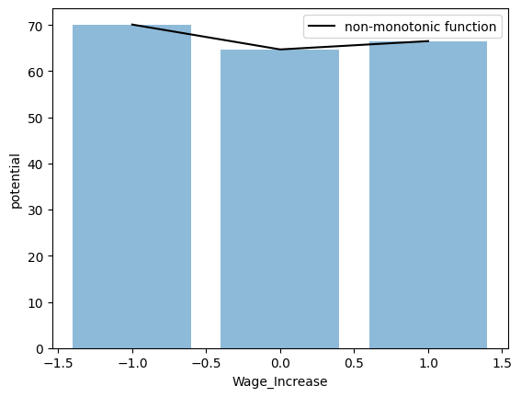
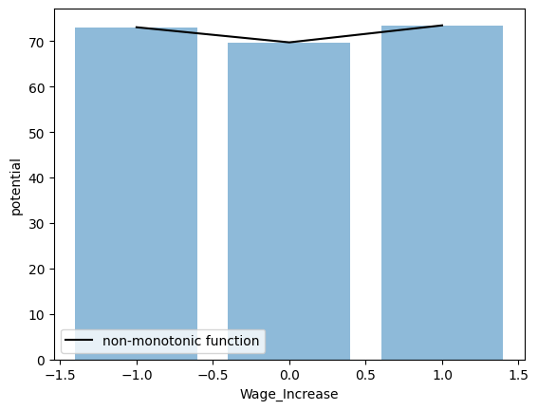
Exploring the New Feature
Notes:
wage doesnt only increase but can decrease also

Slide 23
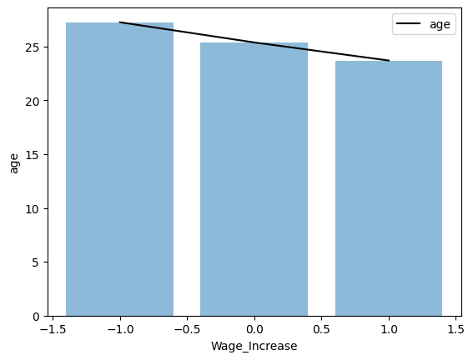
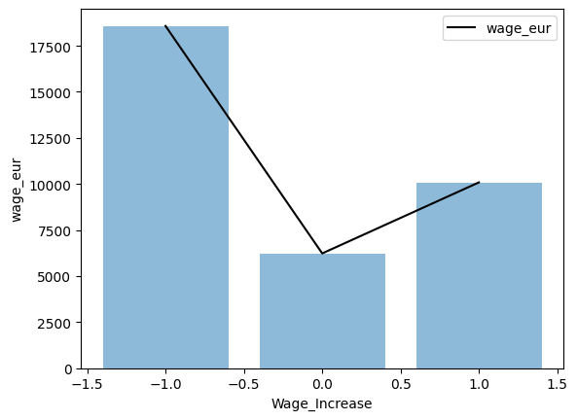
Notes:
wage doesnt only increase but can decrease also

Slide 24
Classification models

Slide 25
Classification models
Models built:
Support vector machine
Adaboost classifier
MLP classifier
Random forest classifier
Bagging classifier
XGBoost classifier
Stacking classifier

Slide 26
Conclusion
The attribute player_traits, player_tags is a short list of football related attributes which can be vectorized using tfidf and used as a feature while training.
The accuracy is can be improved further because there are some other external factors that affect the wages which we need to explore to remove some biases
This model can be pretty good for finding wage increase for especially young players who have different potential that they are yet to reach.
The model required for this task need to be complex.

